Slide 1

American Rescue Plan Act
State And Local Fiscal Recovery Funds

Slide 2
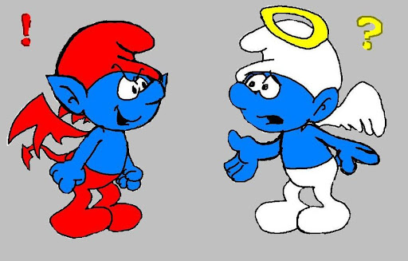

Let’s Give Counties Lots of Money
OK, but do it when the Treasurer’s can lose their minds

Slide 3
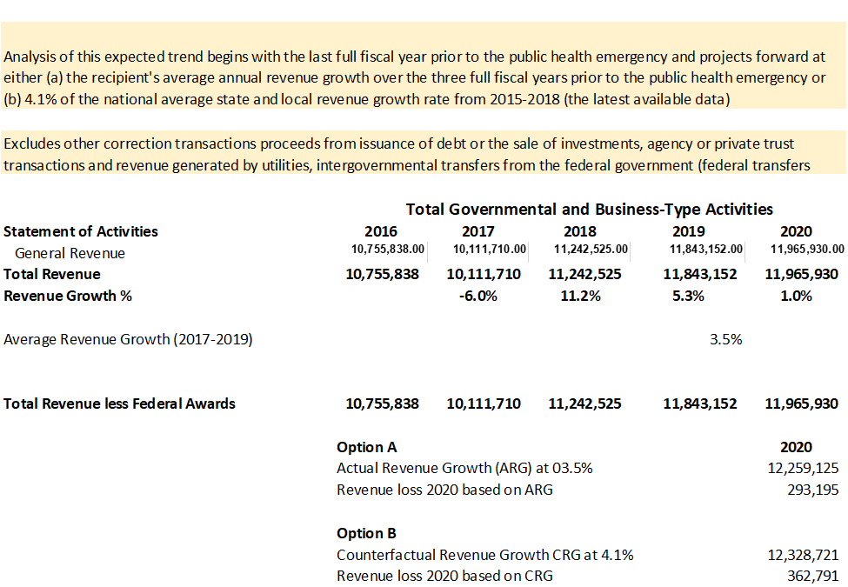

Slide 5
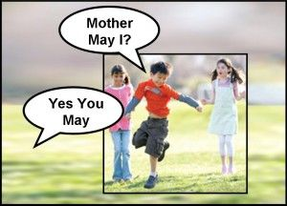

This is Not Like Cures
CURES 2020 ARPA 2021

Slide 6

Two Considerations
US TREASURY
REQUIRED
REPORTING
COUNTY
SINGLE LINE
AUDITS

Slide 7

We be in Uncharted Waters

Slide 8

Where as, we got some money…..
Where as, we do not want a complicated audit…..
Now therefore, we’re going to document our decisions
Make ARPA an Ordinance Driven Process

Slide 9
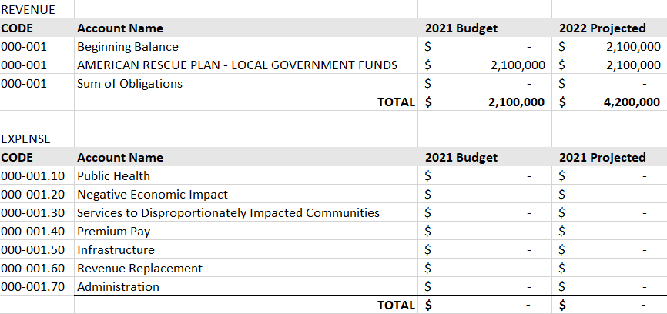
Amend the Budget to Add ARPA

Slide 10
Ordinance Driven Amendments

Slide 11
Process Claims
Against the Amended Budget

Slide 12

Each Amendment To The Budget To Use ARPA Funds Requires
A 2/3 Vote From The Board

Slide 13

How are you keeping track of funds in your County?

Slide 14
Reporting Guidance
Recipient | Interim Report | Project & Expenditure* | Recovery Plan Performance
Cities and Counties with populations above 250,000 | By 8/31/2021 | 1/31/2022 and quarterly thereafter | 8/31/21 and annually on 7/31 thereafter
Metropolitan cities and Counties below 250,000 and receiving more than $10M in SLFRF funding | By 8/31/2021 | 1/31/2022 and quarterly thereafter* | None
Metropolitan cities and Counties below 250,000 and receiving less than $10M in SLFRF funding | By 8/31/2021 | 4/30/2022 and annually thereafter** | None
* Delayed from October 31, 2021
** Still quarterly for Bellwether Counties

Slide 15






ARPA MANAGEMENT PROCESS
Establish Account & Portal
Receive Initial Funds
Define
Plans
Determine Eligibility
Refine Plans
Define Outcomes
Reassess Assumptions
Concurrent with Initial Round
Define Metrics
Receive Second Round Funds
Define Second Round Plans
Determine Eligibility
Refine Second Round Plans
Quarterly Reports
Reassess Assumptions
Define Outcomes
Define Metrics
Quarterly Reports

Slide 16
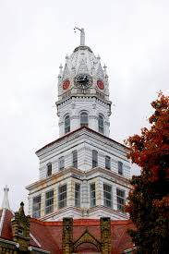

Who Does What?
Potential Use
Reference
Review
Active Project
Draft Ordinance
Refine Description
Refine Metrics
REPORT
JOB-AID

Slide 17
The First Question “Is it Eligible?”
Support Public Health Response COVID Mitigation & Containment Medical Expenses Behavior Healthcare Public Health & Safety Staff | Address Negative Economic Impacts Direct Assistance to the Public Direct Assistance to Small Business Rehire Public Employees Address Impacted Industries
Community Focused Services Community outreach for Health Addressing homelessness Community outreach for Education Promoting Healthy Environments | Water and Sewer Infrastructure Improving access to clean water Investments in wastewater and stormwater infrastructure
Broadband Infrastructure Address unserved / underserved communities | Premium Pay for Essential Workers Additional support for those with greatest risk

Slide 18
Let’s Make it Easy
Was the problem caused by COVID?
Does the solution strengthen current response?
Does the solution strengthen future capabilities?

Slide 19
Clearly Eligible
NO GENERAL FUND OFFSET
CLEARLY ELIGIBLE
PROJECTS
GENERAL FUND OFFSET
American Rescue
Plan Funds
Projects specifically mentioned in the IFR or FAQ or those previously eligible under CURES
AND/OR
Projects not specifically mentioned in the references, but are logical extensions / extrapolations of a referenced use, align to one or more of the US Treasury Expenditure Categories and have an articulable goal addressing a COVID issue

Slide 20
Unaddressed or Unclear Eligibility
Projects not specified in any reference;
but reported as having a benefit addressing a COVID impact or enabling future capabilities.
American Rescue
Plan Funds
UNCLEAR ELIGIBILITY
ASSUMED RISK
LATER CLARIFIED

Slide 21

Second Question “How Far Do You Want to Stretch?”
Leather chairs are easier to clean than cloth?
New flooring is easier to clean than carpeting?
A Snowplow clears the roads and parking lot allowing residents to receive testing and vaccination?

Slide 22
Let’s be Clear About the Risk
“if the Treasury OIG determines that a recipient of payments from the Fund has failed to comply with the use of funds provisions of section 601(d), the amount equal to the amount of funds used in violation of such subsection shall be booked as a debt of such entity owed to the federal government.”

Slide 23
Alternative Funding to Minimize Risk
Some clearly eligible projects create indirect savings in funds already levied
AND/OR
Recovered Lost Revenue may be used for any general government purpose
CLEARLY ELIGIBLE
GENERAL FUND OFFSET
Recovered
Lost Revenue
Alternative Funding
UNCLEAR ELIGIBILITY
ASSUMED RISK

Slide 24
An Example of Indirect Savings
Levied and Collected Funds
ARPR FUNDS
Correction Officer Salaries and Benefits
POTENTIAL USE LIST

Slide 25
Budget Musical Chairs
ARPA Funds General Fund Payroll Clearing
QUARTERLY PAYROLL AMOUNT
Transfer Into Payroll Line Item
Pay Period Deduction
Transfer Equal Levied Funds
Special Use Project
Indirect Savings
Expenses Related to Special Use Project

Slide 26
Every project has two types of metrics
Financial:
How much for what?
How much so far?
How much total?
Operational:
What problem?
What solution?
How long?
Specific milestones?
Specific standards?

Slide 27
ARPA MANAGEMENT PROCESS
Quarterly Reports
FINANCIAL (Amount obligated, Amount expended, Remaining obligation, etc)
Types of Metrics
OPERATIONAL (Measures goal obtainment and impact)
Is the project achieving the goal?
Reassess Assumptions
Is the current use of funds the best approach to the goals?

Slide 28
Example Project Description
HVAC (121)
According to the WHO “The spread of COVID-19 occurs most often when an infected person is in close or direct contact with another person. The risk of the spread of the virus is higher in crowded and poorly ventilated spaces where people spend long periods of time together in close proximity. Improving indoor ventilation can reduce the risk of the virus spreading indoors.”
The CDC concurs that “Improving ventilation is an important COVID-19 prevention strategy that can reduce the number of virus particles in the air.”
EXAMPLE County seeks to improve COVID mitigation by upgrading existing ventilation systems to promote zone control, provide HEPA filtration and other functionalities able to remove small airborne particles (in the size range of 0.1-1 um).

Slide 29
EQUIPMENT PURCHASE
Obligation / Expenditure
INSTALATION
Start Date / Completion
PROJECT METRICS
Financial and Operational
LABOR / SERVICE
Obligation / Expenditure
EXAMPLE County seeks to improve COVID mitigation by upgrading existing ventilation systems to promote zone control, provide HEPA filtration and other functionalities able to remove small airborne particles (in the size range of 0.1-1 um).
CRITERIA
Defined / Achieved

Slide 30
Recap Reporting (Population less than 250,000)
Expenditure Category
Obligation
(Reporting Date)
Expenditure
(Reporting Date)
Project Description
Operations (Goal) Metrics
Project Demographics Statement
Grants / Contracts / Sub-awards
Water / Sewer / Broadband
Required Additional Details
Results Metrics

Slide 31
Who is responsible for collecting metrics in your County?

Slide 32
Understand Expenditure Categories
Categorizes projects based on the goal
Categories may have more than one project
Each project must be listed under a single category
Bellwether will assist in assigning your project to an Expenditure Category
1.0 Public Health
2.0 Negative Economic Impact
3.0 Services to Disproportionately Impacted Communities
4.0 Premium Pay
5.0 Infrastructure
6.0 Revenue Replacement
7.0 Administrative

Slide 33
Common County Submissions
    1.4 Prevention in Congregate Settings (Nursing Homes, Prisons/Jails, Dense Work Sites, Schools, etc.)
      Changes to public access to reduce crowding
      Remodeling to allow employee distance
    1.7 Capital Investments / Physical Plant Changes to Public Facilities that respond to the COVID-19
      HVAC Upgrades
      Remodel / Expand / Acquire improved Public Health Facilities
      Remodel jail processing station for segregating new inmates during screening
    1.8 Other COVID-19 Public Health Expenses (Communications, Enforcement, Isolation/Quarantine)
      Technology
      Signage
US TREASURY REFERENCES EMPHASIZE PROPORTIONATE RESPONSE

Slide 34
Common County Submissions
    1.4 Prevention in Congregate Settings (Nursing Homes, Prisons/Jails, Dense Work Sites, Schools, etc.)
      Changes to public access to reduce crowding
      Remodeling to allow employee distance
    1.7 Capital Investments / Physical Plant Changes to Public Facilities that respond to the COVID-19
      HVAC Upgrades
      Remodel / Expand / Acquire improved Public Health Facilities
      Remodel jail processing station for segregating new inmates during screening
    1.8 Other COVID-19 Public Health Expenses (Communications, Enforcement, Isolation/Quarantine)
      Technology
      Signage
US TREASURY REFERENCES EMPHASIZE PROPORTIONATE RESPONSE

Slide 35
Common County Submissions
  1.9 Payroll Costs for Public Health, Safety, and Other Public Sector Staff Responding to COVID-19
    Attestation of “primary” duty of COVID Mitigation
    Dollar Amount “up to $XX” or Time Frame “12 months”
  1.10 Mental Health Services
    Contracting for additional mental health counselors at schools
    Promoting access to care through transportation
  1.11 Substance Use Services
    Contracting with non-profit providers for Domestic / Drug / Alcohol Crisis Managers
    Promoting access to care through transportation
    Recovery obstacle funding programs
  1.12 Other Public Health Services

Slide 36
Common County Submissions
  2.4 Household Assistance: Internet Access Programs
    Library / Community Center equipment grants
  2.7 Job Training Assistance
    Job Training Programs for ex-employees of impacted industries
    Job Training Programs for QCT / low income impacted communities
  2.9 Small Business Economic Assistance (General)
  2.11 Aid to Tourism, Travel, or Hospitality
    Grants for remodeling requirements for COVID mitigation
    Grants for advertising re-opening
    Grants for events that had prior demonstrated financial impact to local Tourism, Travel and Hospitality
  2.10 Aid to Nonprofit Organizations
    Grants for services provided to impacted communities
    Grants for remodeling community centers that serve impacted communities

Slide 37
Common County Submissions
  3.4 Education Assistance: Social, Emotional, and Mental Health Services
    Contracting for additional mental health counselors at schools
  3.5 Education Assistance: Other
    Facility changes to enable outside class and/or student distancing
  3.6 Healthy Childhood Environments
    Pre / After School programs focused on impacted communities
    Park program subsidies focused on impacted communities
    Athletic facilities improvements for children’s programs
  3.14 Social Determinants of Health: Community Health Workers or Benefits Navigators
    Increased capacity for Crisis Managers
    Relocating core health department functions nearer impacted communities
  3.16 Social Determinants of Health: Community Violence Interventions
    Funding for special Public Safety initiatives addressing violent crime
    Increased capacity for domestic violence resources

Slide 38
Common County Submissions
4.0 Premium Pay
“Fiscal Recovery Funds payments may be used by recipients to provide premium pay to eligible workers performing essential work during the COVID–19 public health emergency or to provide grants to third-party employers with eligible workers performing essential work. These are workers who have been and continue to be relied on to maintain continuity of operations of essential critical infrastructure sectors, including those who are critical to protecting the health and wellbeing of their communities.”
“The ARPA recognizes this by defining premium pay to mean an amount up to $13 per hour in addition to wages or remuneration the worker otherwise receives and in an aggregate amount not to exceed $25,000 per eligible worker.”
“To ensure the provision is implemented in a manner that compensates these workers, the interim final rule provides that any premium pay or grants provided using the Fiscal Recovery Funds should prioritize compensation of those lower income eligible workers that perform essential work.”

Slide 39
Common County Submissions
  5.1 Clean Water: Centralized Wastewater Treatment
  5.2 Clean Water: Centralized Wastewater Collection and Conveyance
  5.3 Clean Water: Decentralized Wastewater
    Multiple projects of various scope
  5.10 Drinking water: Treatment
  5.11 Drinking water: Transmission & Distribution
  5.14 Drinking water: Storage
  5.15 Drinking water: Other water infrastructure
    Multiple projects of various scope
  5.16 Broadband: “Last Mile” projects
  5.17 Broadband: Other projects

Slide 40
Common County Submissions
6.0 Revenue Replacement
  Based on one of two formulas provided by the US Treasury
  Includes all revenue, from all sources, from all department, less federal grant, CARES, CURES or FEMA payments. (not complete description)
  Once identified funds may be moved from ARPA and have fewer restrictions
    Used for general government operations
    May not be used for reserve or service debt prior to March 3, 3021
  Use must still be reported quarterly / annually

Slide 41
Common County Submissions
  7.1 Administrative Expenses
  May be used for internal expenses related to managing the ARPA process
    A portion of salary of the individuals involved
  May be used for external expenses related to managing the ARPA process
    Bellwether LLC
  May be called out specifically as part of other uses of funds where an administrative fee is paid
    Subject to restrictions stated in 2 CFR 200
  7.2 Evaluation and Data Analysis
    Expenses related to preliminary data analysis should be matched to projects with likely execution
  7.3 Transfers to Other Units of Government
    Counties may transfer funds to municipalities and townships, however the county retains the reporting and compliance responsibility

Slide 42
“Our financial picture has challenges, but we have a plan. Thanks Bellwether”
County Board Member 2019
“Part Time Elected Officials Need Full Time Experts”
County Board Member 2020
“When it’s not clear what we should do, it’s clear we should call Bellwether”
County Chairman 2020

